Slide 1
Application Programing Interface (API)

Slide 2
What is API and API Testing?
API (Application Programming Interface) is a computing interface which enables communication and data exchange between two separate software systems.
API TESTING is a software testing type that validates Application Programming Interfaces (APIs). The purpose of API Testing is to check the functionality, reliability, performance, and security of the programming interfaces.

Slide 3
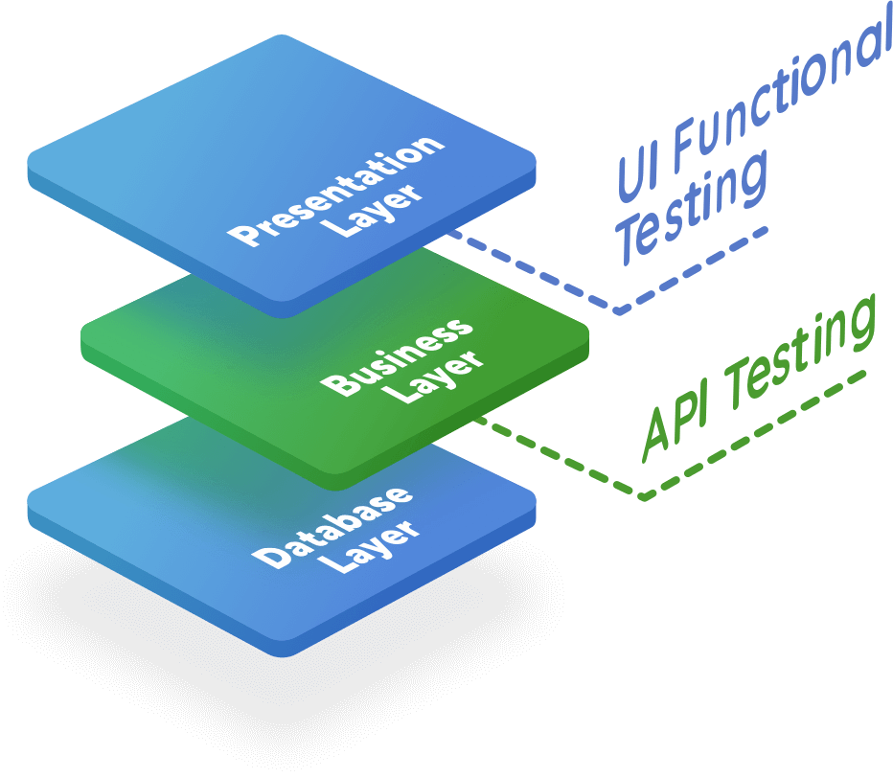
API Testing
In software application (app) development, API is the middle layer between the presentation (UI) and the database layer. APIs enable communication and data exchange from one software system to another.
API testing is performed at the most critical layer of software architecture, the Business Layer. It is in the business layer, business logic processing is carried out, and all transactions between User Interface(UI) and database happen.

Slide 4
Benefits of API Testing
Language-independent: Data is exchanged via XML and JSON formats, so any language can be used for test automation. XML and JSON are typically structured data, making the verification fast and stable. There are also built-in libraries to support comparing data using these data formats.
GUI-independent: API testing can be performed in the app prior to GUI testing. Early testing means early feedback and better team productivity. The app's core functionalities can be tested to expose small errors and to evaluate the build's strengths.
Improved test coverage: Most API/web services have specifications, allowing you to create automated tests with high coverage — including functional testing and non-functional testing.
Faster releases: It is common that executing API testing saves up to eight hours compared to UI testing, allowing software development teams to release products faster.

Slide 5
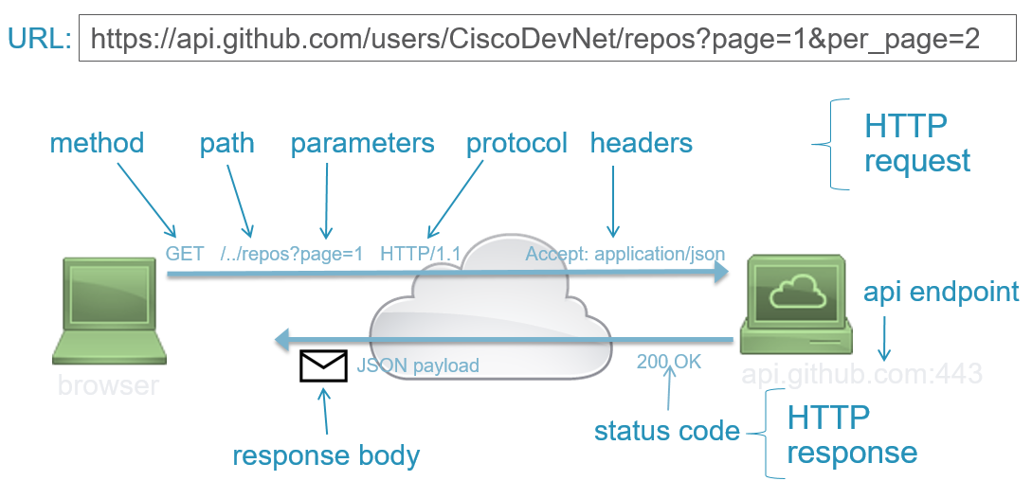
API Request Components
Any REST request includes four essential parts: an HTTP method, an endpoint, headers, and a body.
An HTTP method describes what is to be done with a resource. There are four basic methods also named CRUD operations:
POST to Create a resource,
GET to Retrieve a resource,
PUT to Update a resource, and
DELETE to Delete a resource.
Headers store information relevant to both the client and server. Mainly, headers provide authentication data — such as an API key, the name or IP address of the computer where the server is installed, and the information about the response format.
A body is used to convey additional information to the server. For instance, it may be a piece of data you want to add or replace.
An endpoint contains a Uniform Resource Identifier (URI) indicating where and how to find the resource on the Internet. The most common type of URI is a Unique Resource Location (URL), serving as a complete web address.

Slide 6
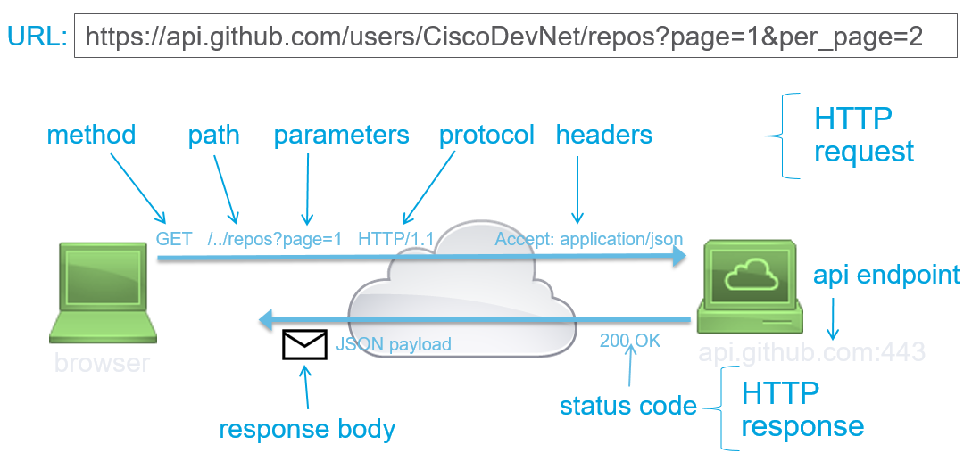
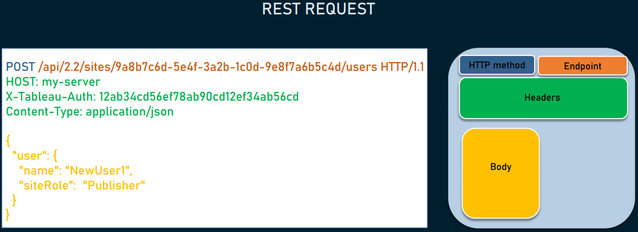
API Request Components

Slide 7
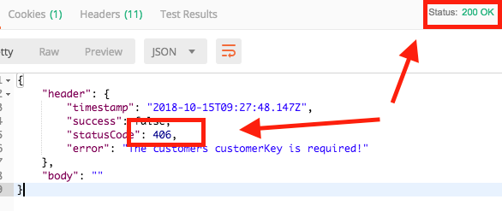
API Response Components
Any REST Response includes three essential parts: status code, Response Header, and Response Body
Status code informs the client if the action was performed correctly or not on the requested resource. It's a number with three digits (between 100 and 599) with a name, like 200 Success, or 404 Not Found. There are many status codes grouped into five main categories: informational responses (1xx), successes (2xx), redirections (3xx), client errors (4xx), and server errors (5xx).
The Response Header contains the information about the content that is being returned in response together with data about the Server that sent it.
The response body contains the requested information in the format specified by the Accept field in the request header. For JSON, the body is typically an object or an array of objects.
Notes:
Let's see some API call scenarios with the corresponding ideal status code:
• GET /users:
o users were successfully retrieved: 200 OK
o consumer is not authenticated: 401 Unauthorized
o server is down: 503 Service Unavailable
• GET /users/1234:
o users with id 1234 was not found: 404 Not Found
• POST /users:
o new user was successfuly created: 201 Created

Slide 8
HTTP Methods and status codes for REST API
Method | Description
GET | Retrieves the information at a particular URL.
PUT | Updates the previous resource if it exists or creates new information at a particular URL.
POST | Used to send information to the server like uploading data and to develop a new entity.
DELETE | Deletes all current representations at a specific URL.
PATCH | This is used for partial updates of resources.
No | Status Code | Description
1 | 1xx (100 – 199) | The response is informational.
2 | 2xx (200 – 299) | Assures successful response.
3 | 3xx (300 – 399) | You are required to take further action to fulfil the request.
4 | 4xx (400 – 499) | There’s a bad syntax and the request cannot be completed.
5 | 5xx (500 – 599) | The server entirely fails to complete the request.

Slide 9
Different Types of API
Web APIs (RESTful APIs)
SOAP APIs
Internal/Private APIs
External/Public APIs
Partner APIs
Open APIs (OpenAPIs)

Slide 10
API Testing Activity
Use this link for practicing API Testing
https://youtu.be/VywxIQ2ZXw4

